Slide 1

Chapter 4 Enhanced Entity-Relationship and UML Modeling

Slide 2
Enhanced-ER (EER) Model Concepts
Includes all modeling concepts of basic ER
Additional concepts: subclasses/superclasses, specialization/generalization, categories, attribute inheritance
The resulting model is called the enhanced-ER or Extended ER (E2R or EER) model
It is used to model applications more completely and accurately if needed
It includes some object-oriented concepts, such as inheritance

Slide 3
Subclasses and Superclasses (1)
An entity type may have additional meaningful subgroupings of its entities
Example: EMPLOYEE may be further grouped into SECRETARY, ENGINEER, MANAGER, TECHNICIAN, SALARIED_EMPLOYEE, HOURLY_EMPLOYEE,…
Each of these groupings is a subset of EMPLOYEE entities
Each is called a subclass of EMPLOYEE
EMPLOYEE is the superclass for each of these subclasses
These are called superclass/subclass relationships.
Example: EMPLOYEE/SECRETARY, EMPLOYEE/TECHNICIAN

Slide 4
Subclasses and Superclasses (2)
These are also called IS-A relationships (SECRETARY IS-A EMPLOYEE, TECHNICIAN IS-A EMPLOYEE, …).
Note: An entity that is member of a subclass represents the same real-world entity as some member of the superclass
A member of the superclass can be optionally included as a member of any number of its subclasses
Example: A salaried employee who is also an engineer belongs to the two subclasses ENGINEER and SALARIED_EMPLOYEE
It is not necessary that every entity in a superclass be a member of some subclass

Slide 5
Attribute Inheritance in Superclass / Subclass Relationships
An entity that is member of a subclass inherits all attributes of the entity as a member of the superclass
It also inherits all relationships

Slide 6
Specialization
Is the process of defining a set of subclasses of a superclass
The set of subclasses is based upon some distinguishing characteristics of the entities in the superclass
Example: {SECRETARY, ENGINEER, TECHNICIAN} is a specialization of EMPLOYEE based upon job type.
May have several specializations of the same superclass
Example: Another specialization of EMPLOYEE based in method of pay is {SALARIED_EMPLOYEE, HOURLY_EMPLOYEE}.
Superclass/subclass relationships and specialization can be diagrammatically represented in EER diagrams
Attributes of a subclass are called specific attributes. For example, TypingSpeed of SECRETARY
The subclass can participate in specific relationship types. For example, BELONGS_TO of HOURLY_EMPLOYEE

Slide 7
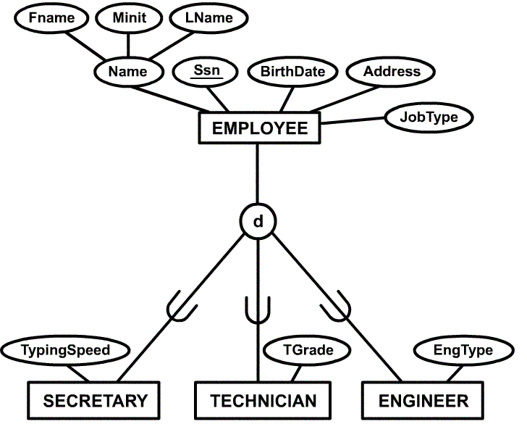
Example of a Specialization

Slide 8
Generalization
The reverse of the specialization process
Several classes with common features are generalized into a superclass; original classes become its subclasses
Example: CAR, TRUCK generalized into VEHICLE; both CAR, TRUCK become subclasses of the superclass VEHICLE.
We can view {CAR, TRUCK} as a specialization of VEHICLE
Alternatively, we can view VEHICLE as a generalization of CAR and TRUCK

Slide 9
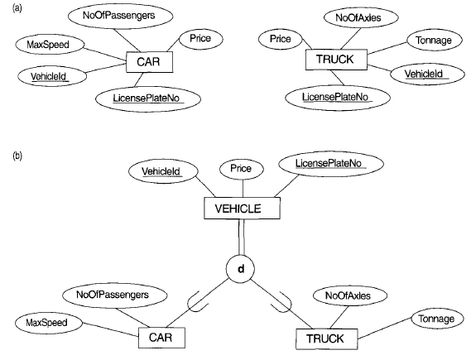
Generalization Example

Slide 10
Constraints on Specialization and Generalization
Two other conditions apply to a specialization/generalization:
Disjointness Constraint:
Specifies that the subclasses of the specialization must be disjointed (an entity can be a member of at most one of the subclasses of the specialization)
Specified by d in EER diagram
If not disjointed, overlap; that is the same entity may be a member of more than one subclass of the specialization
Specified by o in EER diagram
Completeness Constraint:
Total specifies that every entity in the superclass must be a member of some subclass in the specialization/ generalization
Shown in EER diagrams by a double line
Partial allows an entity not to belong to any of the subclasses
Shown in EER diagrams by a single line

Slide 11
Constraints on Specialization and Generalization (3)
Hence, we have four types of specialization/generalization:
Disjoint, total
Disjoint, partial
Overlapping, total
Overlapping, partial
Note: Generalization usually is total because the superclass is derived from the subclasses.

Slide 12
Example of disjoint partial Specialization

Slide 13
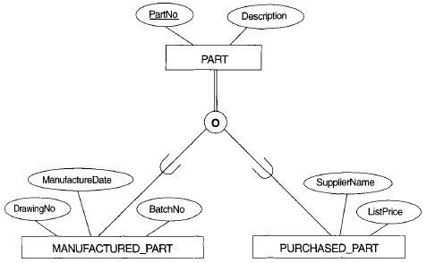
Example of overlapping total Specialization

Slide 14
Specialization / Generalization Hierarchies and Lattices
A subclass may itself have further subclasses specified on it
Forms a hierarchy or a lattice
Hierarchy: every subclass has only one superclass (called single inheritance)
Lattice: a subclass can be subclass of more than one superclass (called multiple inheritance)
A subclass with more than one superclass is called a shared subclass
In specialization, start with an entity type and then define subclasses of the entity type by successive specialization (top down conceptual refinement process)
In generalization, start with many entity types and generalize those that have common properties (bottom up conceptual synthesis process)
In practice, the combination of two processes is employed

Slide 15
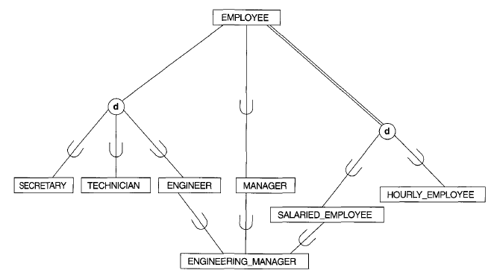
Specialization Lattice with shared subclass

Slide 16
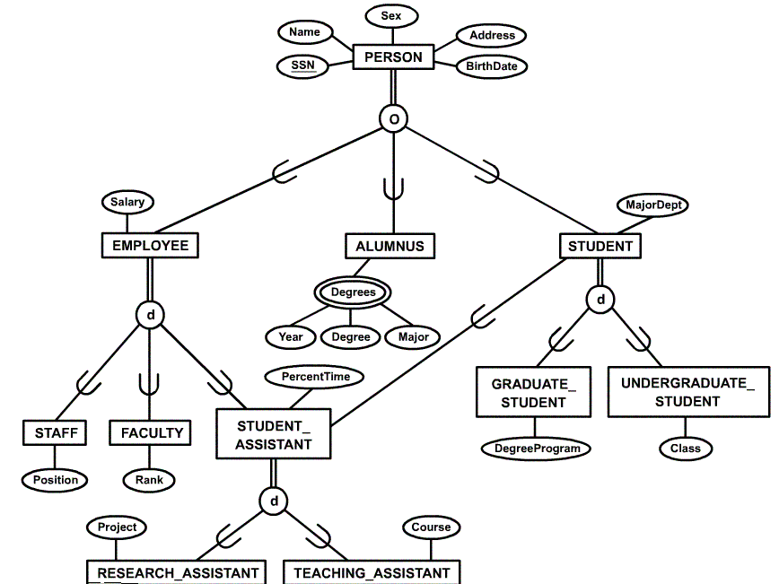
Specialization Lattice Example (UNIVERSITY)

Slide 17
Categories (UNION TYPES)
The shared subclass that represent a subset of the UNION of distinct entity types is called a category or UNION TYPE
Example: Database for vehicle registration, vehicle owner can be a person, a bank (holding a lien on a vehicle) or a company.
Category (subclass) OWNER is a subset of the union of the three superclasses COMPANY, BANK, and PERSON
A category member must exist in at least one of its superclasses
Note: The difference from shared subclass, which is subset of the intersection of its superclasses (shared subclass member must exist in all of its superclasses).

Slide 18
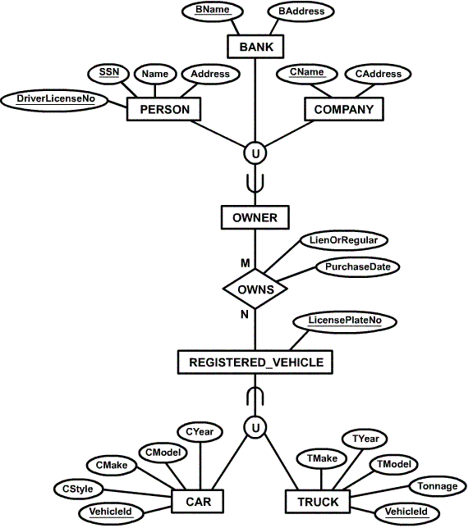
Example of categories (UNION TYPES)

Slide 19
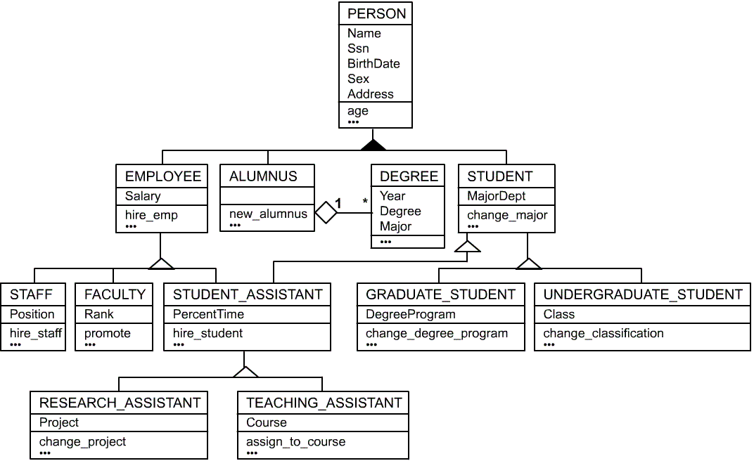
UML Example for Displaying Specialization / Generalization

Slide 20
EX: online auction database system
The online site has members who are identified by a unique member id and are described by an email, a name, a password, and a phone number.
A member may be a buyer or a seller. A buyer has a shipping address recorded in the database. A seller has a bank account number and routing number recorded in the database.
Items are identified by a unique item number. Items are also described by an item title, type, starting bid price, and the start date of the auction.
For all items of type FOOD, the system record the expiration date and the supplier name.

Slide 21
EX: Inventory System
Each Item has a unique code, name, cost, and price.
Each person the system deal with is identified by a unique ID number, name, date of birth. A person may be a customer or supplier or both.
For each customer the system keeps his address and a phone number.
For each supplier the system keeps his company name
Each item has only one supplier and each supplier must provide one or more items.
Each customer may buy one or more Items

